Slide 1

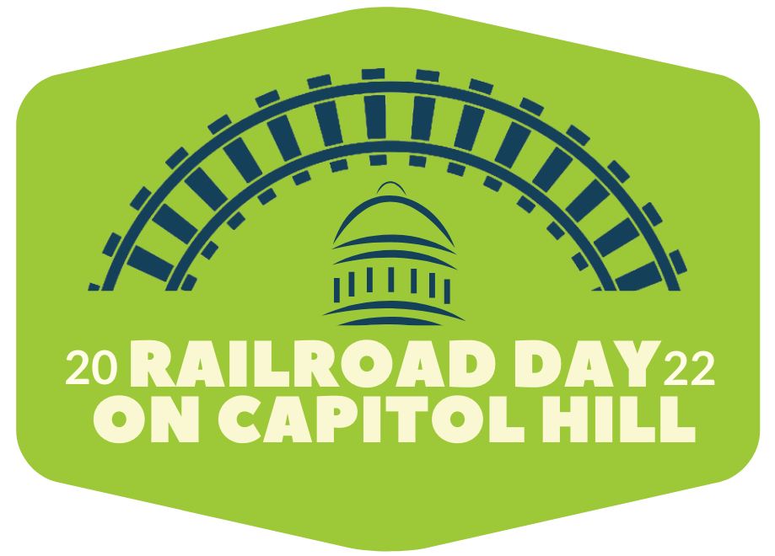


We’re excited to meet you!
Here’s what we’ll cover today.
Support full funding and streamlined implementation of the IIJA to improve efficiencies, safety and environmentally friendly freight transportation.
Preserve balanced economic regulation against efforts that would adversely impact the railroads' ability to invest now and into the future or the economic regulatory balance established under existing federal law.
Oppose all efforts to increase truck length or weight limits, including any pilot programs or special exemptions for commodities.
Introductions
Railroad 101
Three Asks

Slide 2


Thank You!
@AAR_FreightRail @ASLRRA #RailDay2022
AAR.org/Railroad-Day
Bi-weekly Newsletter: AAR.org/Signal

